Slide 1
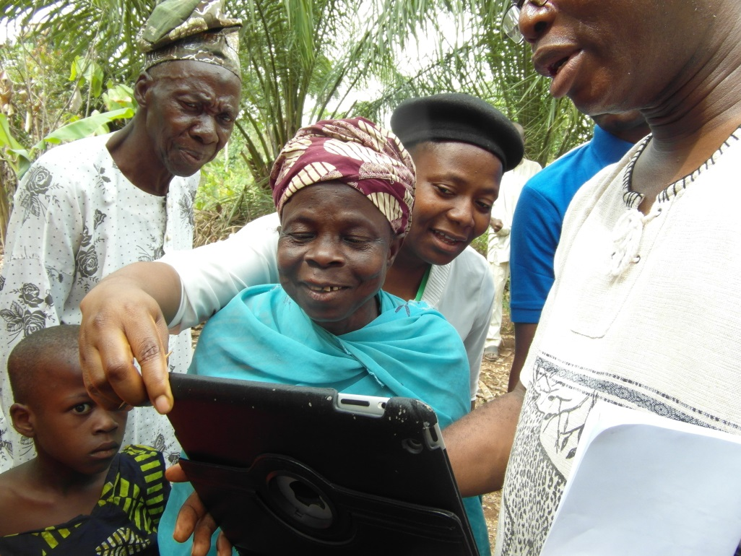
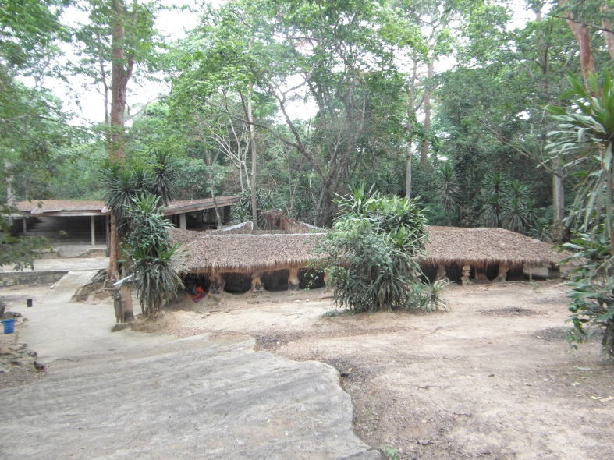
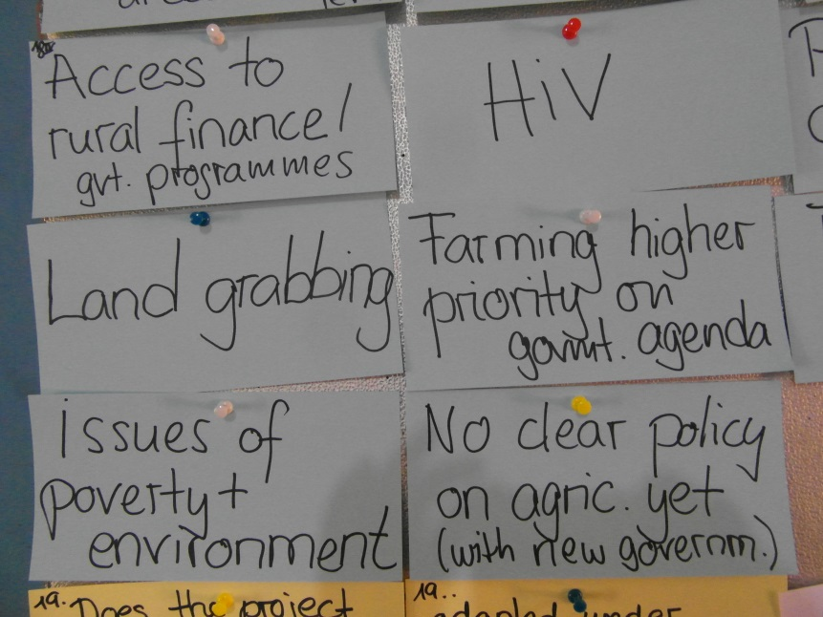



CONTEMPORARY ISSUES IN AGRICULTURAL EXTENSION
Prof. Dixon Olutade Torimiro

Slide 2
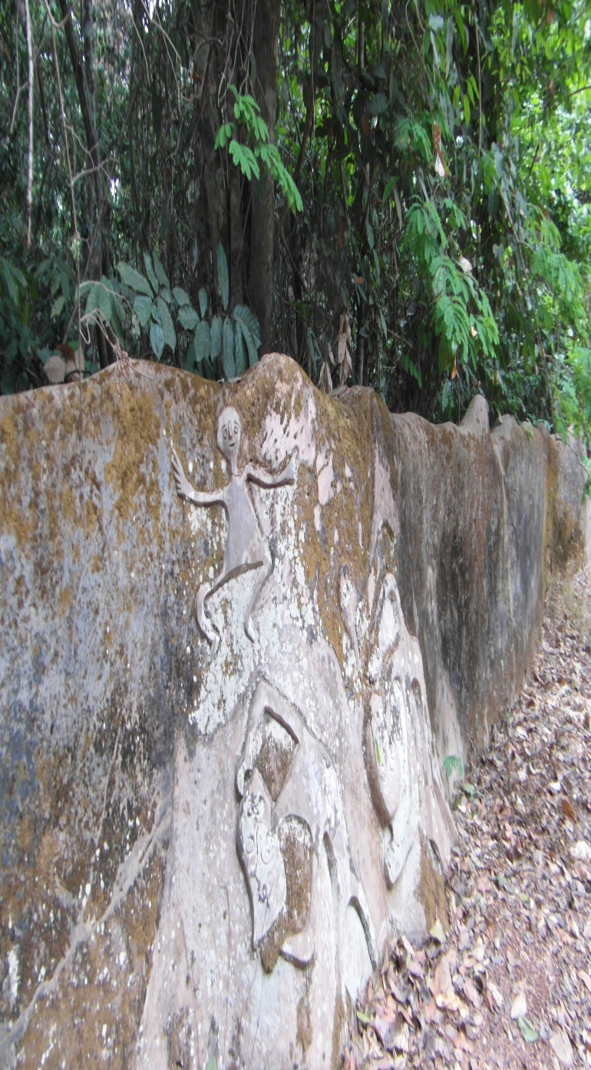
EXTENSION: HISTORY AND CONCEPTS EXPLORED
THE EARLY EXTENSION PRACTICE
The first known example of agricultural extension was discovered in Mesopotamia (roughly present day Iraq) around 1800 B.C. when Archaeologists unearthed clay tablets on which were inscribed advice on watering crops and getting rid of rats – important for mitigating any potential loss of taxation revenue from farmers¹ .
Around the same time, more or less institutionalized forms of agricultural extension were also recorded to have existed in ancient Egypt, Greece and Phoenicia².

Slide 3
EXTENSION: HISTORY AND CONCEPTS EXPLORED CONT’D.
From the 2nd century B.C. to the 4th century A.D., several important Latin texts were written, frequently drawing on practical farming experience, which aimed to help Roman landowners to maintain and improve their estates and their revenues³.
In imperial China, begun by the late Han Dynasty (25-220 A.D.) culminated into the oldest fully surviving Chinese agricultural treatise entitled: Essential Techniques for the Peasantry, dating from 535 A.D. which aimed to show landowners how to improve their estate management through the advise they gave to their tenants².

Slide 4

EXTENSION: HISTORY AND CONCEPTS EXPLORED CONT’D.
The Sung and Yuan Dynasties (960-1368) with their firm local government administrations were notable in organizing and promoting agricultural research, extension work, and the teaching of agriculture and sericulture, much facilitated by the invention of woodblock printing, which allowed agricultural treatises and practical handbooks to be widely distributed^{4,5,6,7}.
Ming (1368-1644) and Chi’ing (1644-1912) Dynasties, continued similar activities driven not only by the growing population and periodic threats of famine, but also by the state’s recognition of the importance of well coordinated extension work on agricultural recommendations if the most benefit was to be achieved^{4,5,6,7}.

Slide 5
EXTENSION: HISTORY AND CONCEPTS EXPLORED CONT’D.
MODERN AGRICULTURAL EXTENSION
The term ‘extension’ itself is more recent; it originates from academia, and its common use was first recorded in Britain in the 1840s, in the context of ‘university extension’ or ‘extension of the university’. By the 1880s the work was being referred to as the ‘extension movement^{’2} .
In this movement the university extended its work beyond the campus. In a similar vein, the term ‘extension education’ has been used in the USA since the early 1900s to indicate that the target group for university teaching should not be restricted to students on campus but should be extended to people living anywhere in the state. Within a short time, the idea had spread to other parts of Britain, Europe and North America².

Slide 6
EXTENSION: HISTORY AND CONCEPTS EXPLORED CONT’D.
The term ‘’Agricultural Extension’’ was only adopted in 1914 when the United States Federal Smith-Lever Act of 1914 formalized a nationwide cooperative federal-state-county programme and gave operational responsibility for this to the land grant Colleges and Universities.
In the beginning, agricultural extension was concerned primarily with the improvement of agriculture, using conventional teaching methods. As time went on, home economics, youth programmes and rural community resource development were included. Agricultural extension spread to tropical Africa, the Caribbean, Asia and Latin America following the involvement of the USA in bilateral AID programmes after the Second World War.

Slide 7
WHY IS AGRICULTURAL EXTENSION SO IMPORTANT?
THE GOVERNMENTAL GOALS TO WHICH AGRICULTURAL EXTENSION POLICIES AND ACTIVITIES CAN SIGNIFICANTLY CONTRIBUTE⁸
Increasing food production
Stimulating economic growth
Increasing the welfare of farm families and rural people
Reducing poverty and social inequalities
Sustainable use of natural resources
Participatory development
Agricultural extension in its broadest sense in considered an important instrument to support farmers’ efforts in agricultural development in a changing environment.

Slide 8
EVOLVING MODELS OF AGRICULTURAL EXTENSION
Lineal Model
Extension Farmer
Tripartite Model
Extension Farmer
Research

Slide 9
CHANGING MODELS OF AGRICULTURAL EXTENSION CONT’D.
Research
Extension
Farmer
Input
Linkage System
Systemic Extension Model
Men
Research
Extension
Farm family
Input
Women
Children
Modified Systemic Extension Model

Slide 10
RECENT CHANGES AND TRENDS IN EXTENSION
1. Paternalistic views of those supported by agricultural extension services
Rationale: Realization that rural people are viewed as subjects who are dependent on external structures and are helpless and weak and unable to take their destiny into their own hands.
Target groups - people chosen for certain interventions planned by outsiders
Beneficiaries - people worked with who should benefit from certain actions
The poor - the development targets of donors seeking to alleviate poverty.
Extension users should not be treated as subjects but rather as actors - clients, producers, sponsors, users and stakeholders, acknowledging their objectives and potentials.

Slide 11
RECENT CHANGES AND TRENDS IN EXTENSION CONT’D.
2. Decentralization
Rationale: Realization of the development decisions can be best made by officials at the grass-root levels due to being physically close to the farming populations.
Decentralization of extension services requires a policy backed up by political commitment, which regulates the transfer of authority and financial resources, determines local responsibilities, and establishes the mechanisms for public participation and social monitoring.

Slide 12
RECENT CHANGES AND TRENDS IN EXTENSION CONT’D.
3. Pluralism^{9,10.}
Rationale: Realization of the governments’ inability to continue providing all the services previously offered due to rising cost, limited resources, etc.
A plurality of extension services is therefore required to support the producers and the rural poor by undertaking various extension activities.
The role of public sector extension in pluralistic service systems must be that o assuring quality and enhancing the demand capacity of the client system.

Slide 13
RECENT CHANGES AND TRENDS IN EXTENSION CONT’D.
4. Privatization
Rationale: Realization of the inefficiency, reduced government funding and commodification of agricultural knowledge have created the drive towards privatization of public extension services.
The institutional arrangements for privatization may involve a range of modalities for financing and delivering extension services, including outsourcing, cost recovery etc.
Due to inherent weaknesses identified in private extension, public sector must work to strengthen the private sector in terms of capacity building, quality assurance etc.

Slide 14
RECENT CHANGES AND TRENDS IN EXTENSION CONT’D.
5. Widening perspectives
Rationale: Realization of the fact that extension is no longer an isolated activity because it operates within a larger knowledge system that includes research, education and support systems.
Extension is embedded within a wider service context, including credit, input supply, processing, marketing, communication and information services.
Now that the value chain approach is being used as a new strategy for agricultural and rural development, extension services can be offered along the value chain by various actors.
Some relevant issues for consideration are HIV/AIDS, climate change, environmental education etc.

Slide 15
RECENT CHANGES AND TRENDS IN EXTENSION CONT’D.
6. Participation
Rationale: Realization of the need for mechanism for public participation and social control in extension work for a better involvement and integration of all the stakeholders in adapting technologies to their conditions.
In a top down governmental system or in a strongly hierarchical culture, genuine participation cannot be introduced.
The farm families, that is, men, women and children must be involved in participatory research and extension activities using appropriate strategies.

Slide 16
ISSUES IN RESEARCH EXTENSION LINKS
Who defines the problems and the research topics?
Who benefits from the results?
How can research and extension be better linked?

Slide 17
Weakness in extension research and possible remedies¹¹
weakness | Possible remedies
Faults in organization
Multiplicity in institutions Rivalries and disputes concerning responsibilities No appropriate mix between budget and competitive funding Little exchange of ideas Inadequate planning and co-ordination Research programs depend on individuals Little continuity of research No organizational link with extension | Drawing up master plans for research, optimizing the institutional set-up Establishing mid-term plans and annual updates Transparent allocation of funds and encouragement to apply for competitive funds Foster continuous exchange by seminars, workshops, excursions, conferences and joint publications Give researchers a career perspective and ensure continuity
Remoteness from practical applications
Scientists’ ambition and desire for promotion Presentation of results at conferences, congresses and in peer reviewed international journals Unwillingness to take unconventional action | Decision in aims of research taken by both development institutions and client groups Involvement of scientists in the problem-solving process pf practitioner (field days, joint excursions, discussions) More action-research and alternative methods Considering practical application in criteria of promotion

Slide 18
Lack of relation to the client group
Failure to involve farmers in decisions on the content of research and in carrying out research Research results of no use to the mass of farmers | Setting up research programs among the client groups and involving them in the implementation Translating research results to ensure that they are easily understood by advisers and client groups Producing regional farming handbooks that incorporate conclusions and recommendations from recent research
One-sidedness
Designed to achieve short-term success Neglecting side effect and undesired long-term effects Ignoring local knowledge and know-how | Designing research over a longer time-scale and as an inter- and transdisciplinary program. Reinforcing long-term holistic ways of looking at problems, doing systems research

Slide 19
FARMERS’ POTENTIAL CONTRIBUTION TO RESEARCH COMPARED WITH THAT OF RESEARCHERS¹¹
Farmers | Researchers
Are generalists Are (soft) systems developers Use phenomenology Deal with complexity, whole farm and family, natural and social environment… | Are specialists Are (isolated, theoretical) hard systems knowledge generators Use analytical (natural) science Reduce complexity to isolated cause-effect relations
Holism Do “black box experimentation” only considering input-output, no throughput, although the output has successfully passed through the box Reach generalized conclusions from concrete events and observations | Reductionism Do analytical experimentation, where isolated factors risk losing effect when put into contexts involving complexity Create undesired side-effects through interactions with intervening variables Confirm theory through experimentation
Induction Easy evaluations of results ( researcher is user) Create locally bound and mainly tacit knowledge and locally adapted technology Open for intuition, subconscious perceptions, feelings… Have highly trained and general observation skills | Deduction Difficult evaluation of results (user’s preferences and the complexity of user’s situation are not well known) Create basic, universal and explicit knowledge, general principles, laws Eliminate non-rational, irrational aspects Are narrow focused, “biased by hypothesis”

Slide 20
Research situation Work in life long longitudinal case study set-up Experience a unity of study, work and life | Research situation Work on short-term, cross-sectional research projects Experience a separation between their work and the farmer’s work and their own private life
Sampling, variables and trials Have whole populations or very large samples of observation Have unlimited variations of input, some targeted, most of them accidentally Are several thousand times more numerous than researchers Represent approx. 6000 cultures with their diverse perceptions and practices | Sampling, variables and trials Have smaller (but representative) samples in observation, but more overview across farms Have very limited variations of input, according to experimental designs. No room for chance Are several thousand times less numerous than farmers. Represent one “scientific culture” with a unified world view
Open-mindedness Tolerate contradictions and unexplainable phenomena (e.g. acupuncture) | Narrow-mindedness Cannot tolerate contradictions or unexplainable events and mechanisms

Slide 21
Communication and credibility Exchange knowledge through manifold networks, but also by open visibility of most on-farm innovations | Communication and credibility Exchange knowledge by publications and conferences. Competition hampers full exchange and inhibits visibility of on-station trials.
farmers | Researchers
Encodes messages orally and also in action and in objects Communication is personal and creates high credibility for farmers Farmers are neighbors with comparable socialization Adoption of “farmers’ innovations” is of lower risk | Encode messages literally, in text and visual representation Communication is anonymous, impersonal with lower credibility for farmers Researchers are more distant to each other and their communication suffers from barriers between disciplines Adoption of “researcher’ innovations” bears more risk

Slide 22
ISSUES IN RESEARCH EXTENSION LINKS CONT’D.
Some proven research approaches in extension:
Participatory Learning Action Research (PLAR)
Innovation Platform (IP)

Slide 23
REFERENCES
1. Ahmed, A. (1982). The role of the information systems in development . Studies Series, No. 314. Baghdad, Iraq: Ministry of Culture and Information.
2. Jones, G.E. and Garforth, C. (1997). The History, Development and Future of Agricultural Extension. In; Swanson, B. E., Bentz, R. P. & Sofranko, A. J., Improving Agricultural Extension. A Reference Manual. F.A.O. Rome, 3 -12.
3. White, K.D. (1970). Roman farming. London: Thames and Hudson.
4. Perkins, D. H. (1969). Agricultural development in China, 1368 – 1968, Chicago; Aldine Publishing; Edinburgh: Edinburgh University Press.
5. Elvin, M. (1973). The Pattern of the Chinese Past. London: Methuen.
6. Bray, F. (1984). Joseph Needham’s science and civilization in China: Vol. 6, Biology and biological technology. Pt. II: Agriculture, Cambridge: Cambridge University Press.
7. Delman, J. (1991). Agricultural extension in Renshou Country, China: A case-study of bureaucratic intervention for agricultural innovation and change. Aarhus, Denmark: Institute of East Asian Studies.
8. Hoffmann, V. , Thomas, A. and Gerber, A. (eds.) (2009). Transdiszciplinare Umweltforschung. Methodenhandbuch. oekom verlag, Munchen, 272pp.
9. Hoffmann, V., Kidd, A. and Lamers, J. (1998). Towards pluralism in agricultural extension: A growing challenge to the public and private sectors. In: agriculture and rural development Vol. 5, No. 1, S, 7-10.
10. Kidd, A. D., Lamers, J. P. A., Facarelli, P. P. and Hoffmann, V. (2000). Privatizing agricultural extension. “Caveat emptor” . In: Journal of Rural Studies 16, S. 95 – 102.
11. Hoffmann, V., Gerster-Bentaya, M., Christinck, A. and A. Lemma (2009).Handbook: Rural Extension Vol.1, Basic Issues and Concepts. Margret Publishers GmbH, Scientific books. Kanalstraße 21; D-97990, Weikersheim. Pp114, 118.
(

Slide 24
THANK YOU FOR YOUR ATTENTION

